Slide 1
Dermoscopy-based Skin Disease Detection Powered by Edge AI
6501 Group 12
Jiarui Xing, Kinson Fang, Jeanu Joo

Slide 2

Background
Automated diagnosis of melanoma, a lethal form of skin cancer

Slide 3
ML Model
Resnet 18
Hardware: Google Dev Board Micro
Dataset: ISIC Challenge Datasets
Training data:
900 dermoscopic lesion images +900 entries of gold standard malignant status.
Test data:
379 images of the exact same format as the Training Data.

Slide 4
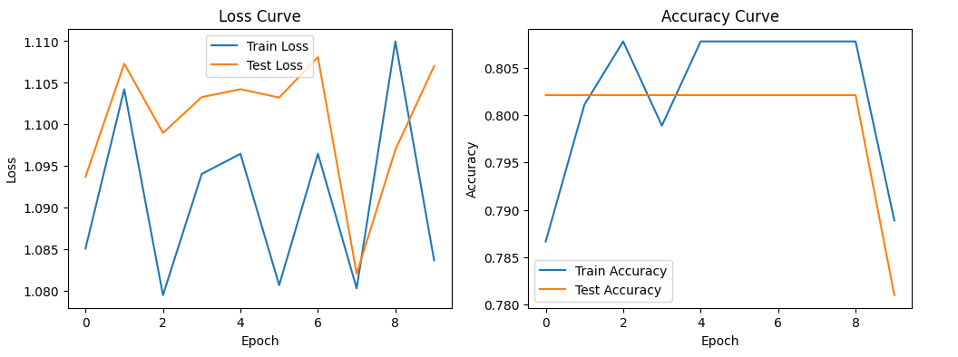

Slide 5
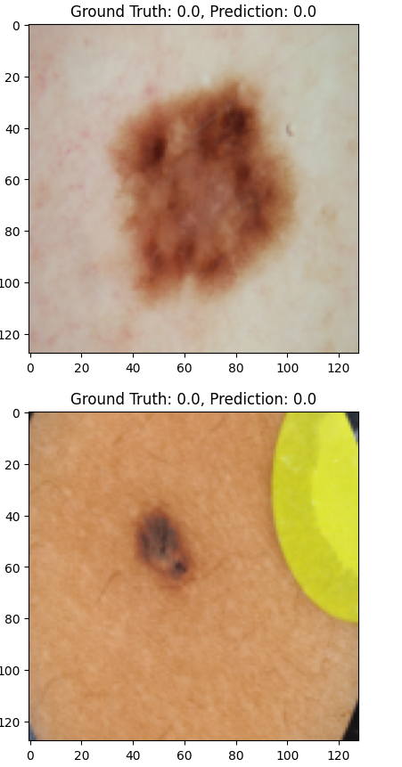
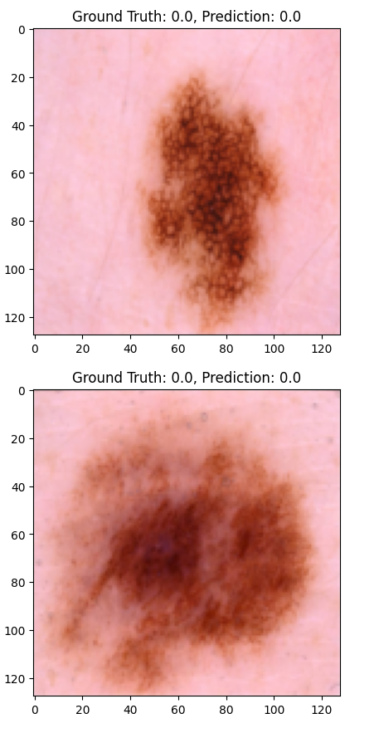
Accuracy over 80%

Slide 6
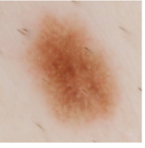
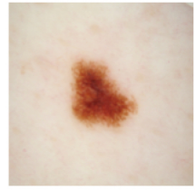


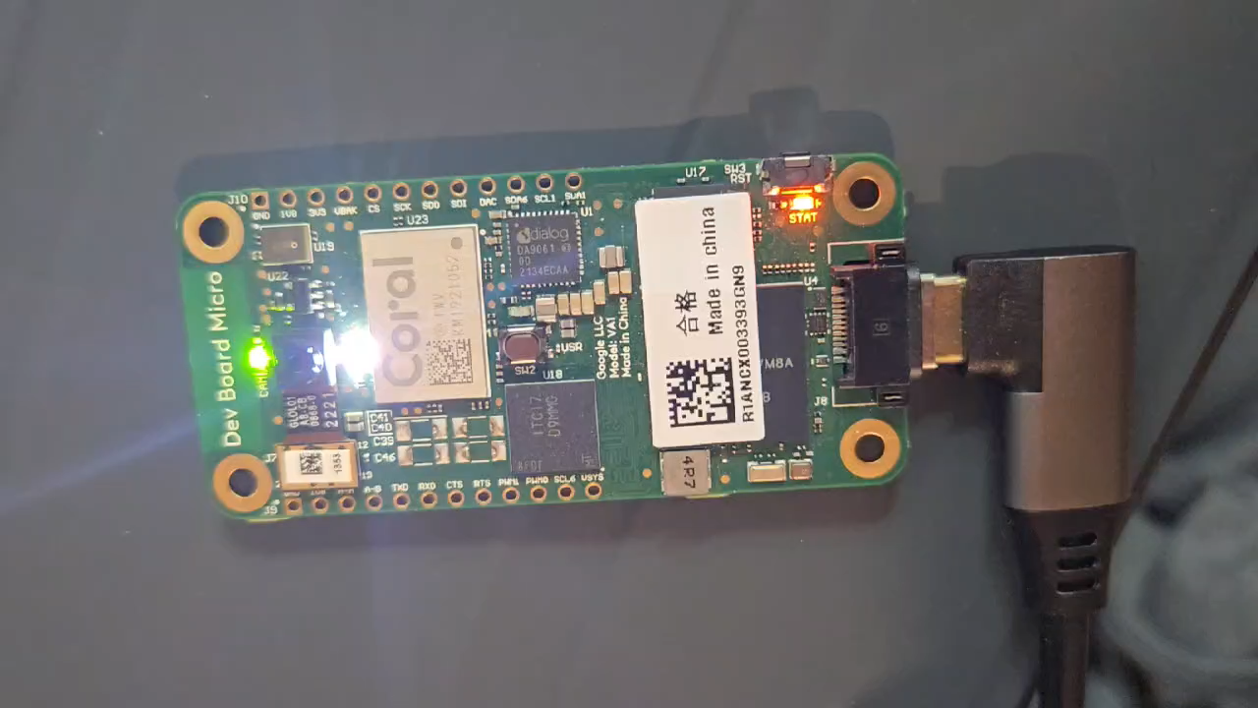
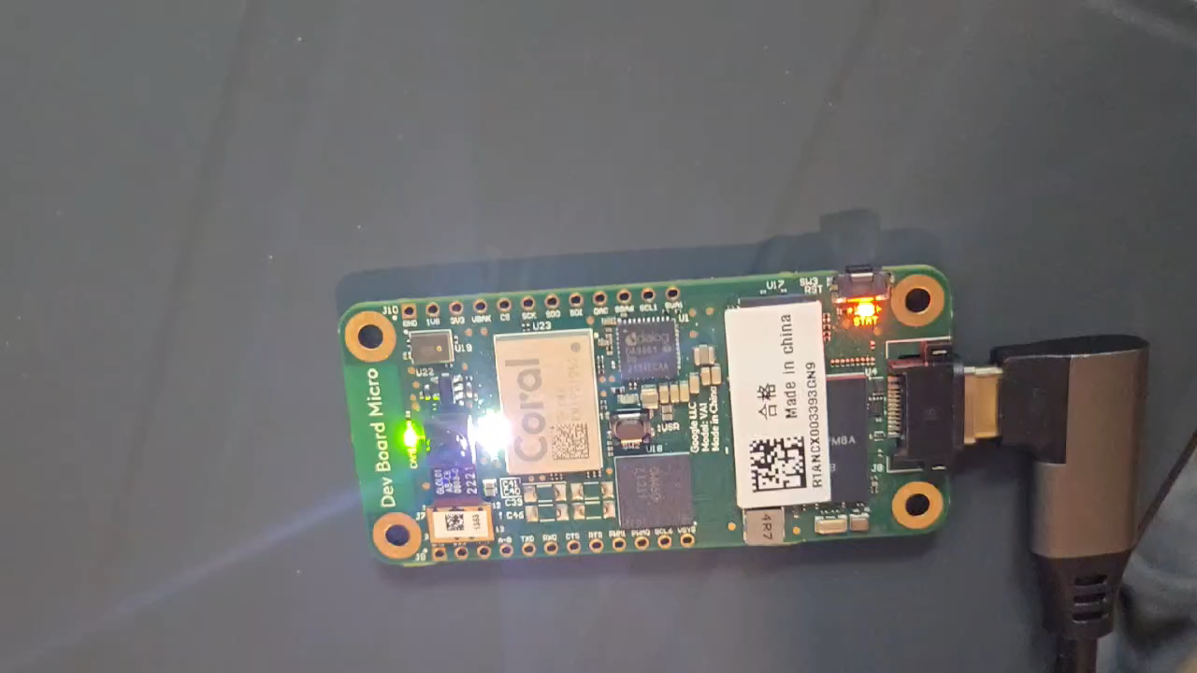

Slide 7
Existing problem:
Dataset too small (2016_900)
Overfit
Imbalanced dataset

Slide 8
Solution:
Hyperparameter Tuning：
Lower the learning rate and adjust the pos_weight to balance positive
and negative samples.
Regularization:
Add Dropout or L2 regularization to prevent overfitting.
Dataset expansion:
Expand the training data to improve the model's generalization ability.
Early Stopping:
Stop training early when the test loss starts to increase.

